Slide 1

EARLIER DETECTION OF PARKINSON’S DISEASE FROM BRAIN MRI IMAGE USING DEEP LEARNING TECHNIQUIES
Guided By Presented By
Dr. A Anny Leema C. Keerthi Reddy - 20BBS0023
Anshu Reddy Ashanna - 20BBS0141

Slide 2
EARLIER DETECTION OF PARKINSON’S DISEASE FROM BRAIN MRI IMAGE USING DEEP LEARNING TECHNIQUES

Slide 3
INTRODUCTION TO THE DOMAIN
Deep learning is a subset of machine learning, which is essentially a neural network with three or more layers. These neural networks attempt to simulate the behaviour of the human brain—albeit far from matching its ability—allowing it to “learn” from large amounts of data. While a neural network with a single layer can still make approximate predictions, additional hidden layers can help to optimize and refine for accuracy.
Deep learning drives many artificial intelligence (AI) applications and services that improve automation, performing analytical and physical tasks without human intervention.
Deep learning technology lies behind everyday products and services (such as digital assistants, voice-enabled TV remotes, and credit card fraud detection) as well as emerging technologies (such as self-driving cars).

Slide 4
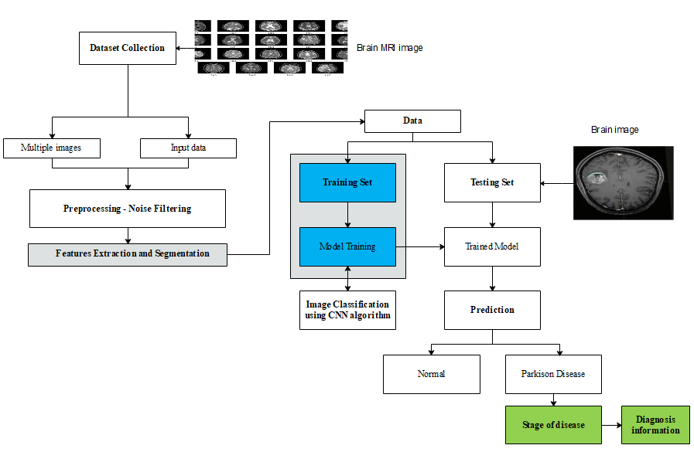
SYSTEM ARCHITECTURE

Slide 5
METHODOLOGY ADAPTED
Preprocessing – Median filtering algorithm
Median filtering is a nonlinear process useful in reducing impulsive, or salt-and-pepper noise.
The median filter is also used to preserve edge properties while reducing the noise.
Also, the smoothing techniques, like gaussian blur is also used to reduce noise but it can’t preserve the edge properties.
The median filter is widely used in digital image processing just because it preserves edge properties.

Slide 6
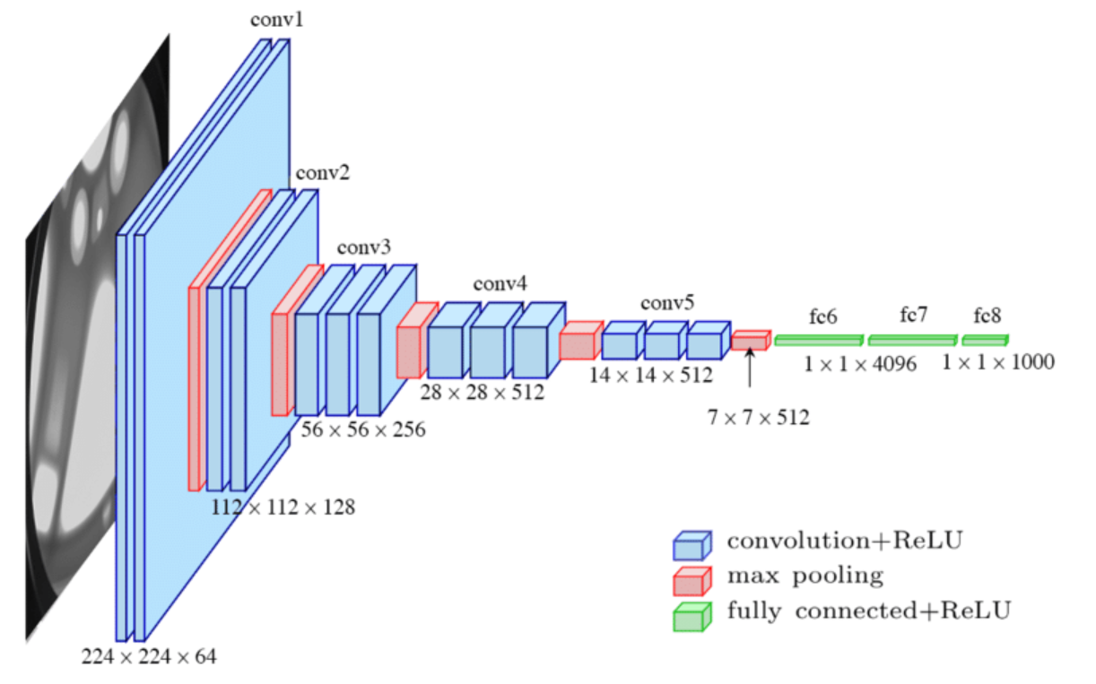
CONVOLUTIONAL NEURAL NETWORK ALGORITHM

Slide 7
ALGORITHM STEPS
Convolutional layer. The majority of computations happen in the convolutional layer, which is the core building block of a CNN. A second convolutional layer can follow the initial convolutional layer. The process of convolution involves a kernel or filter inside this layer moving across the receptive fields of the image, checking if a feature is present in the image.
Pooling layer. Like the convolutional layer, the pooling layer also sweeps a kernel or filter across the input image. But unlike the convolutional layer, the pooling layer reduces the number of parameters in the input and also results in some information loss. On the positive side, this layer reduces complexity and improves the efficiency of the CNN.
Fully connected layer. The FC layer is where image classification happens in the CNN based on the features extracted in the previous layers. Here, fully connected means that all the inputs or nodes from one layer are connected to every activation unit or node of the next layer.

Slide 8
MODULES
Datasets Acquisition
Pre-processing
Features Extraction
Model Training
Disease Classification

Slide 9
MODULES DESCRIPTION
DATASETS ACQUISITION
Parkinson's disease (PD) is a chronic and progressive neurodegenerative disorder that affects movement and motor control. It is caused by the degeneration of dopamine-producing cells in the brain, which leads to a reduction in the levels of dopamine, a neurotransmitter that is involved in the regulation of movement.
Brain image acquisition refers to the process of obtaining images of the brain for the purpose of diagnosis or research.
Magnetic Resonance Imaging (MRI): MRI uses a powerful magnetic field and radio waves to produce detailed images of the brain and other parts of the body.
In this module, we can input the brain image to predict the Parkinson diseases.

Slide 10
MODULES DESCRIPTION
PREPROCESSING:
Preprocessing in image processing refers to the set of operations that are performed on an image before it is analyzed or processed further.
The goal of preprocessing is to enhance the image quality and to make it easier to extract meaningful information from the image.
Image resizing refers to the process of changing the size of an image, either by increasing or decreasing its dimensions. Image resizing is an important step in image preprocessing, as it can be used to adjust the size of an image to fit specific requirements or to make it easier to process and analyze.
And then remove the noises using median filtering algorithm
Median filtering is a technique used for removing noise from images. It works by replacing each pixel in the image with the median value of the surrounding pixels in a local neighborhood.

Slide 11
MODULES DESCRIPTION
FEATURES EXTRACTION
Feature extraction in images refers to the process of identifying and extracting meaningful information or characteristics from an image. The extracted features can be used to represent the image in a compact and descriptive manner, and they can be used as inputs to machine learning algorithms for image classification, segmentation, and other tasks.
Image descriptors are a type of feature representation that captures the shape, texture, and/or color information of an image or image region.

Slide 12
MODULES DESCRIPTION
MODEL TRAINING
Model training in classification is an important step in many computer vision and medical imaging applications, where accurate and efficient classifiers are crucial for making accurate predictions and decisions.
Model training in classification refers to the process of learning a classifier from labeled training data.
The goal of model training is to learn a mapping from the input features to the corresponding class labels, so that the classifier can be used to predict the class label of new, unseen data.
In this module using Convolutional neural network algorithm to classify the pixels

Slide 13
MODULES DESCRIPTION
DISEASE CLASSIFICATION
Disease classification refers to the process of categorizing diseases into specific groups based on their features
In this module, disease can be classified as Parkinson disease or not
After that provide the precaution details about predicted disease

Slide 14
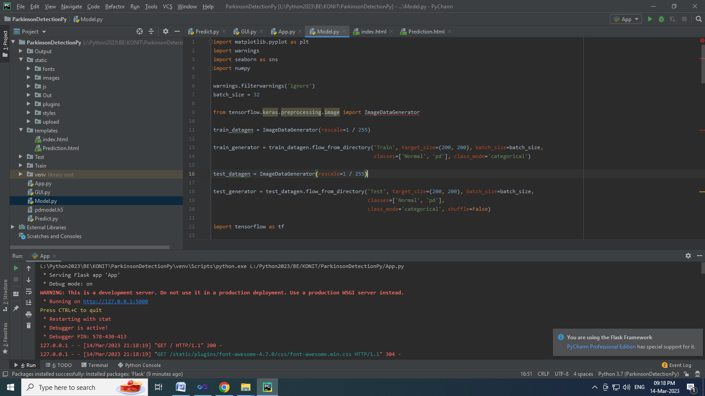
IMPLEMENTATION

Slide 15
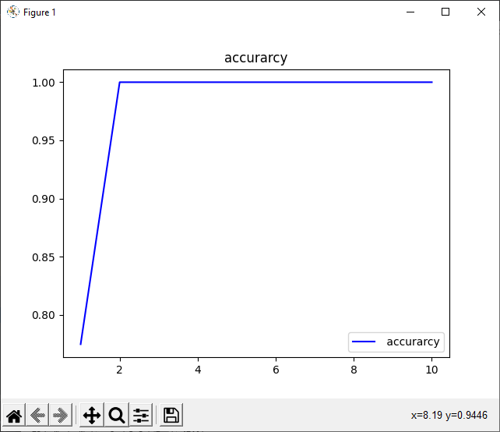
IMPLEMENTATION- TRAINING ACCURACY

Slide 16
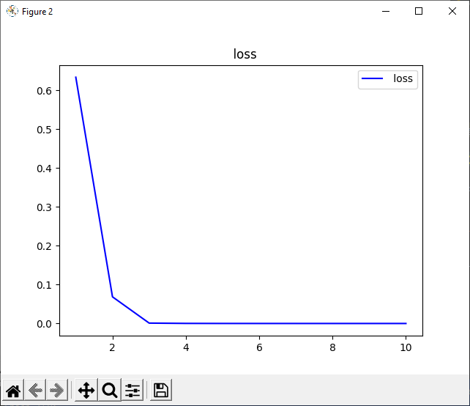
IMPLEMENTATION – TRAINING LOSS

Slide 17
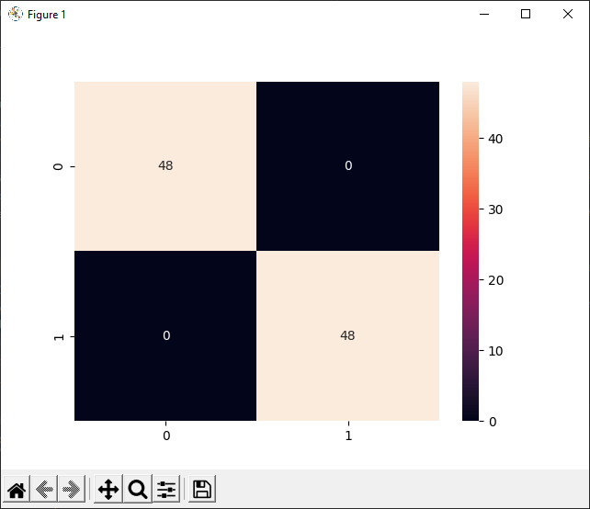
CONFUSION MATRIX

Slide 18
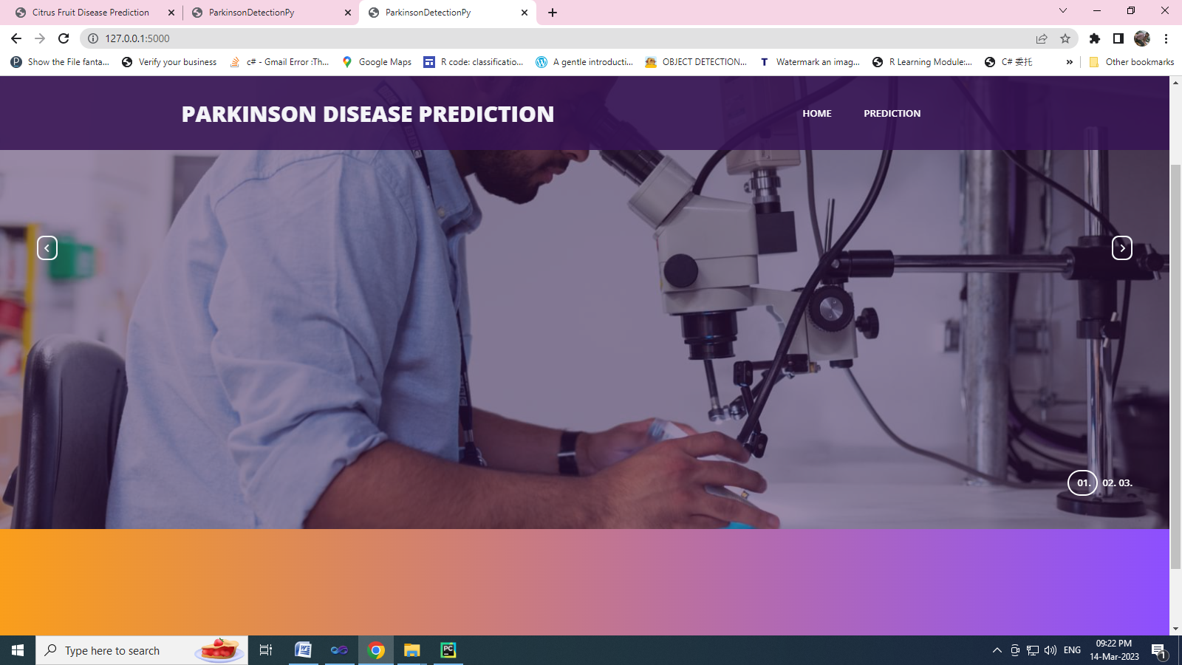
PARKINSON DISEASE PREDICTION

Slide 19
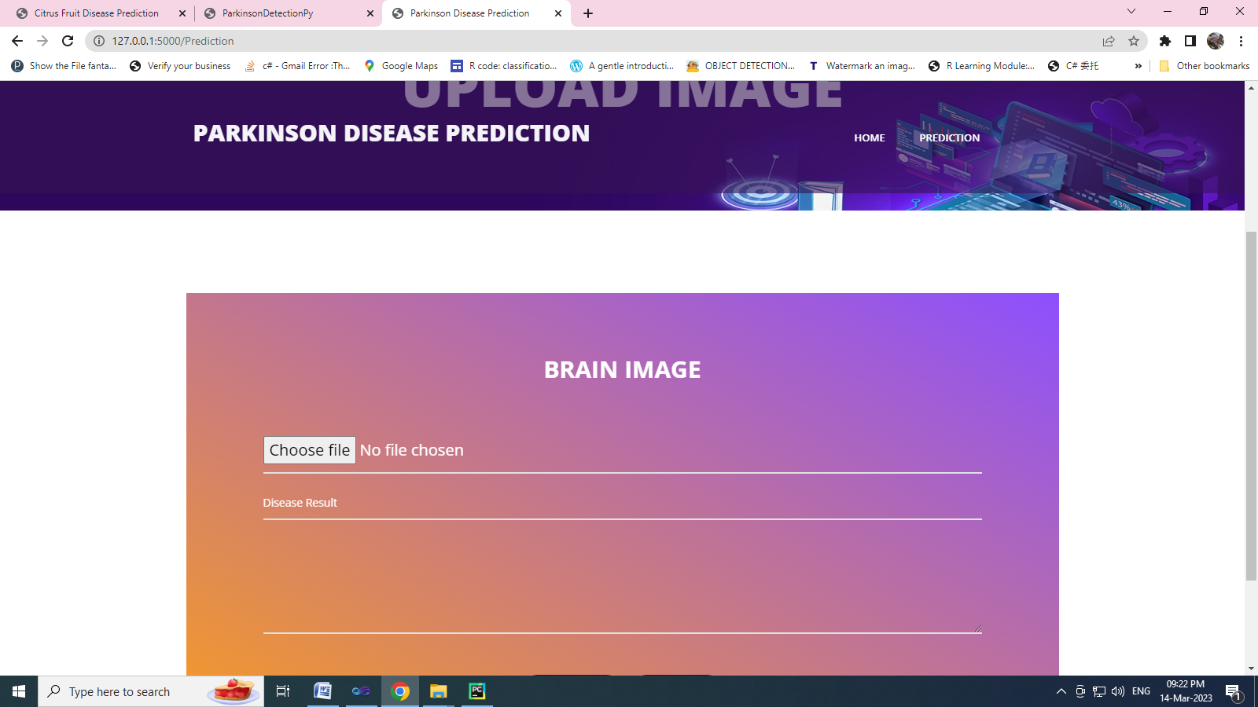
BRAIN IMAGE

Slide 20
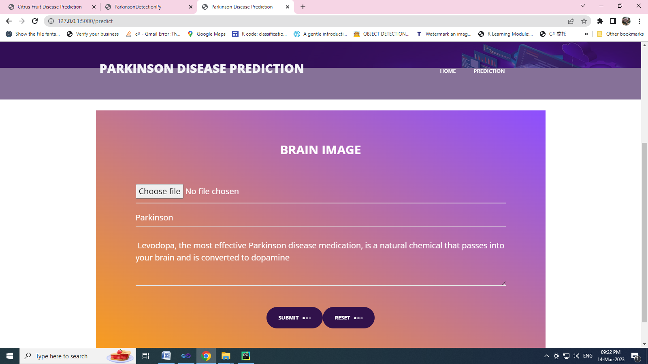
DISEASE PREDICTION

Slide 21
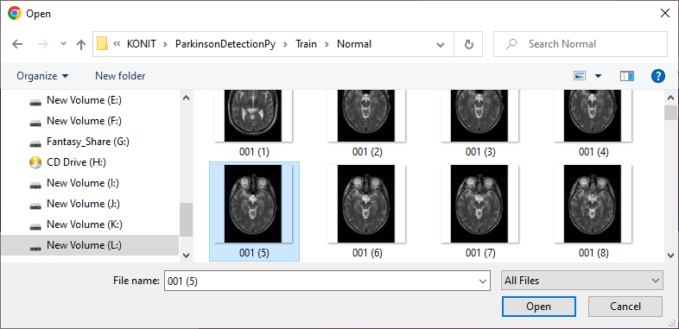
NORMAL PERSON

Slide 22
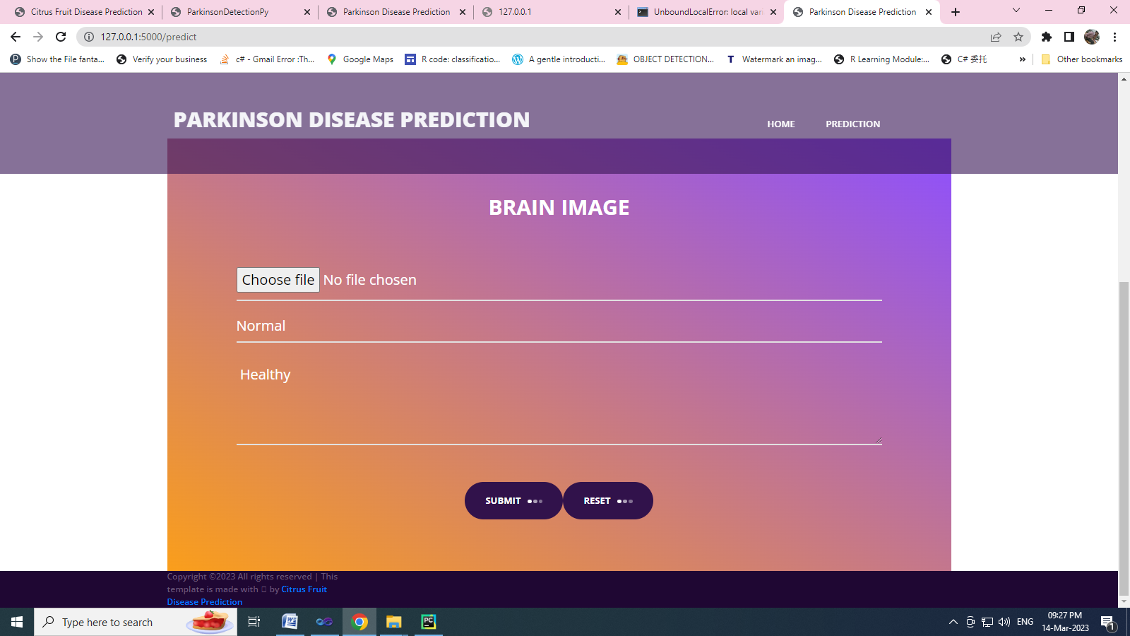
NORMAL PERSON DETECTION

Slide 23
REFERENCES
Ali, Mahnoor, et al. "Brain tumour image segmentation using deep networks." IEEE Access 8 (2020): 153589-153598.
Majib, Mohammad Shahjahan, et al. "Vgg-scnet: A vgg net-based deep learning framework for brain tumor detection on mri images." IEEE Access 9 (2021): 116942-116952.
Ahmed, Md Rishad, et al. "Single volume image generator and deep learning-based ASD classification." IEEE Journal of Biomedical and Health Informatics 24.11 (2020): 3044-3054.
Deng, Wu, et al. "Deep learning-based HCNN and CRF-RRNN model for brain tumor segmentation." IEEE Access 8 (2020): 26665-26675.
Sravan, V., et al. "Magnetic resonance images based brain tumor segmentation-a critical survey." 2020 4th international conference on trends in electronics and informatics (ICOEI)(48184). IEEE, 2020.

